Slide 2
1 Relativity I: Time, Space, and Motion
© Gary N. Felder and Kenny M. Felder 2023.

Slide 3
1 Relativity I: Time, Space, and Motion
© Gary N. Felder and Kenny M. Felder 2023.

Slide 4
1 Relativity I: Time, Space, and Motion
© Gary N. Felder and Kenny M. Felder 2023.

Slide 5
2 Relativity II: Dynamics
© Gary N. Felder and Kenny M. Felder 2023.

Slide 6
2 Relativity II: Dynamics
© Gary N. Felder and Kenny M. Felder 2023.

Slide 7
2 Relativity II: Dynamics
© Gary N. Felder and Kenny M. Felder 2023.

Slide 8
2 Relativity II: Dynamics
© Gary N. Felder and Kenny M. Felder 2023.

Slide 9
2 Relativity II: Dynamics
© Gary N. Felder and Kenny M. Felder 2023.

Slide 10
2 Relativity II: Dynamics
© Gary N. Felder and Kenny M. Felder 2023.

Slide 11
2 Relativity II: Dynamics
© Gary N. Felder and Kenny M. Felder 2023.

Slide 12
3 The Quantum Revolution I: From Light Waves to Photons
© Gary N. Felder and Kenny M. Felder 2023.

Slide 13
3 The Quantum Revolution I: From Light Waves to Photons
© Gary N. Felder and Kenny M. Felder 2023.

Slide 14
3 The Quantum Revolution I: From Light Waves to Photons
© Gary N. Felder and Kenny M. Felder 2023.

Slide 15
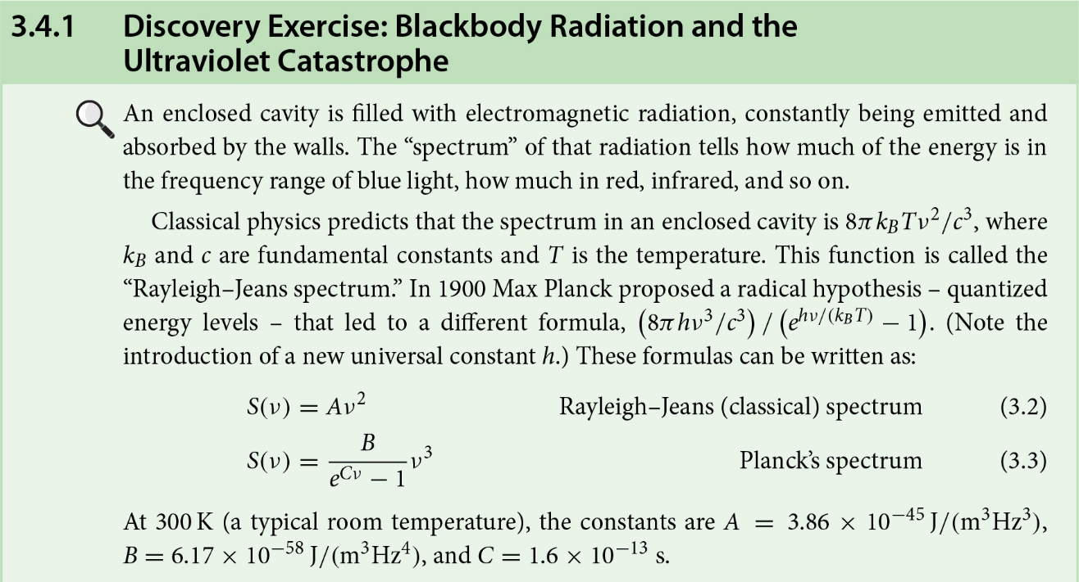
3 The Quantum Revolution I: From Light Waves to Photons
© Gary N. Felder and Kenny M. Felder 2023.

Slide 16
3 The Quantum Revolution I: From Light Waves to Photons
© Gary N. Felder and Kenny M. Felder 2023.

Slide 17
3 The Quantum Revolution I: From Light Waves to Photons
© Gary N. Felder and Kenny M. Felder 2023.

Slide 18
4 The Quantum Revolution II: Matter and Wavefunctions
© Gary N. Felder and Kenny M. Felder 2023.

Slide 19
5 The Schrödinger Equation
© Gary N. Felder and Kenny M. Felder 2023.

Slide 20
5 The Schrödinger Equation
© Gary N. Felder and Kenny M. Felder 2023.

Slide 21
5 The Schrödinger Equation
© Gary N. Felder and Kenny M. Felder 2023.

Slide 22
5 The Schrödinger Equation
© Gary N. Felder and Kenny M. Felder 2023.

Slide 23
5 The Schrödinger Equation
© Gary N. Felder and Kenny M. Felder 2023.

Slide 24
6 Unbound States
© Gary N. Felder and Kenny M. Felder 2023.

Slide 25
6 Unbound States
© Gary N. Felder and Kenny M. Felder 2023.

Slide 26
6 Unbound States
© Gary N. Felder and Kenny M. Felder 2023.

Slide 27
6 Unbound States
© Gary N. Felder and Kenny M. Felder 2023.

Slide 28
6 Unbound States
© Gary N. Felder and Kenny M. Felder 2023.

Slide 29
7 The Hydrogen Atom
© Gary N. Felder and Kenny M. Felder 2023.

Slide 30
7 The Hydrogen Atom
© Gary N. Felder and Kenny M. Felder 2023.

Slide 31
7 The Hydrogen Atom
© Gary N. Felder and Kenny M. Felder 2023.

Slide 32
7 The Hydrogen Atom
© Gary N. Felder and Kenny M. Felder 2023.

Slide 33
7 The Hydrogen Atom
© Gary N. Felder and Kenny M. Felder 2023.

Slide 34
8 Atoms
© Gary N. Felder and Kenny M. Felder 2023.

Slide 35
8 Atoms
© Gary N. Felder and Kenny M. Felder 2023.

Slide 36
9 Molecules
© Gary N. Felder and Kenny M. Felder 2023.

Slide 37
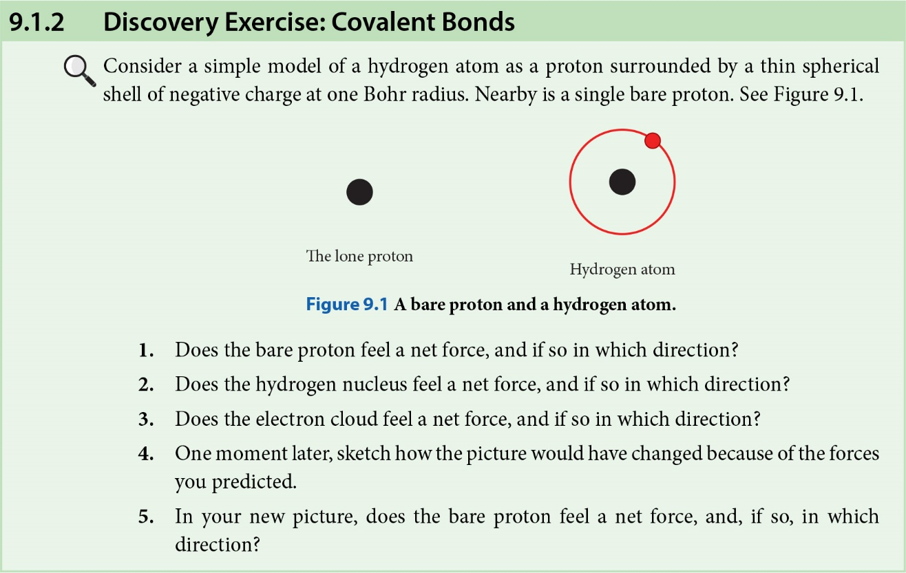
9 Molecules
© Gary N. Felder and Kenny M. Felder 2023.

Slide 38
10 Statistical Mechanics
© Gary N. Felder and Kenny M. Felder 2023.

Slide 39
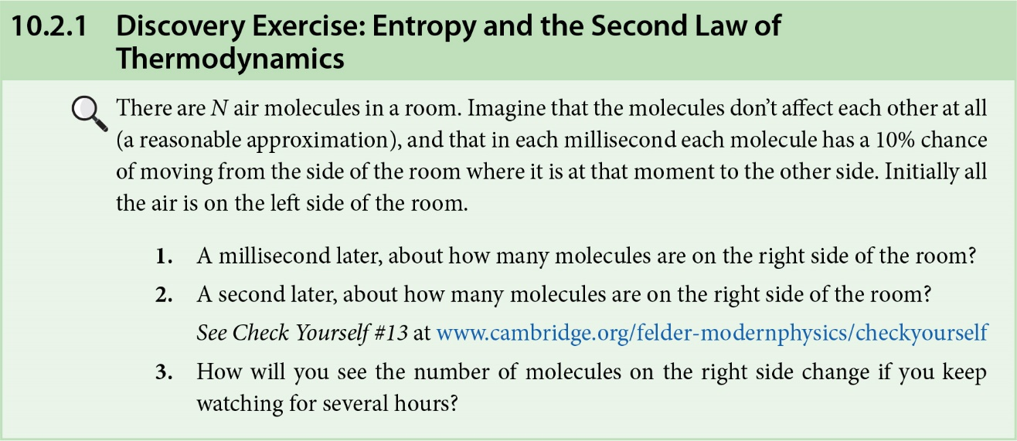
10 Statistical Mechanics
© Gary N. Felder and Kenny M. Felder 2023.

Slide 40
10 Statistical Mechanics
© Gary N. Felder and Kenny M. Felder 2023.

Slide 41
10 Statistical Mechanics
© Gary N. Felder and Kenny M. Felder 2023.

Slide 42
10 Statistical Mechanics
© Gary N. Felder and Kenny M. Felder 2023.

Slide 43
10 Statistical Mechanics
© Gary N. Felder and Kenny M. Felder 2023.

Slide 44
10 Statistical Mechanics
© Gary N. Felder and Kenny M. Felder 2023.

Slide 45
11 Solids
© Gary N. Felder and Kenny M. Felder 2023.

Slide 46
11 Solids
© Gary N. Felder and Kenny M. Felder 2023.

Slide 47
11 Solids
© Gary N. Felder and Kenny M. Felder 2023.

Slide 48
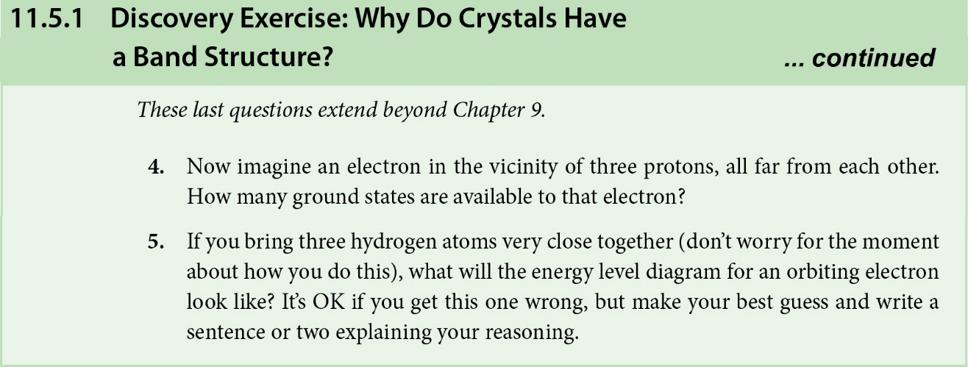
11 Solids
© Gary N. Felder and Kenny M. Felder 2023.

Slide 49
11 Solids
© Gary N. Felder and Kenny M. Felder 2023.

Slide 50
12 The Atomic Nucleus
© Gary N. Felder and Kenny M. Felder 2023.

Slide 51
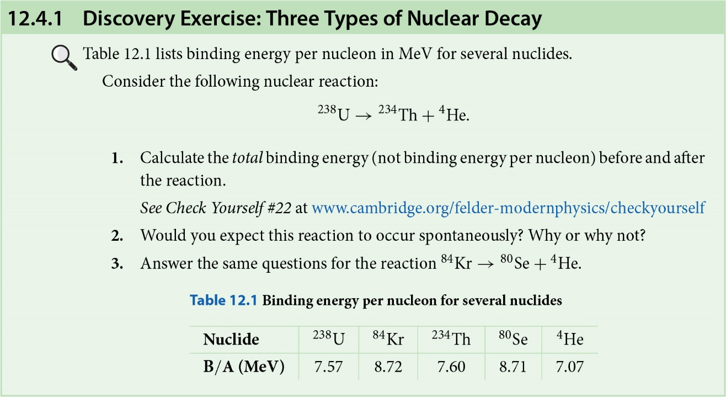
12 The Atomic Nucleus
© Gary N. Felder and Kenny M. Felder 2023.

Slide 52
12 The Atomic Nucleus
© Gary N. Felder and Kenny M. Felder 2023.

Slide 53
13 Particle Physics
© Gary N. Felder and Kenny M. Felder 2023.

Slide 54
13 Particle Physics
© Gary N. Felder and Kenny M. Felder 2023.

Slide 55
14 Cosmology
© Gary N. Felder and Kenny M. Felder 2023.

Slide 56
14 Cosmology
© Gary N. Felder and Kenny M. Felder 2023.

Slide 57
14 Cosmology
© Gary N. Felder and Kenny M. Felder 2023.

Slide 58
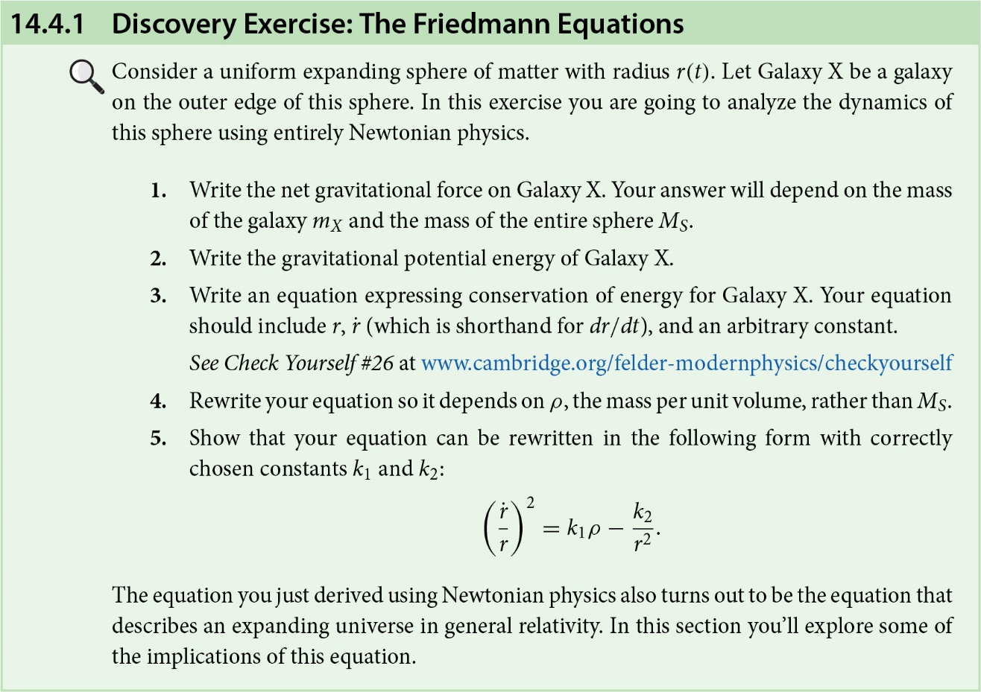
14 Cosmology
© Gary N. Felder and Kenny M. Felder 2023.

Slide 59
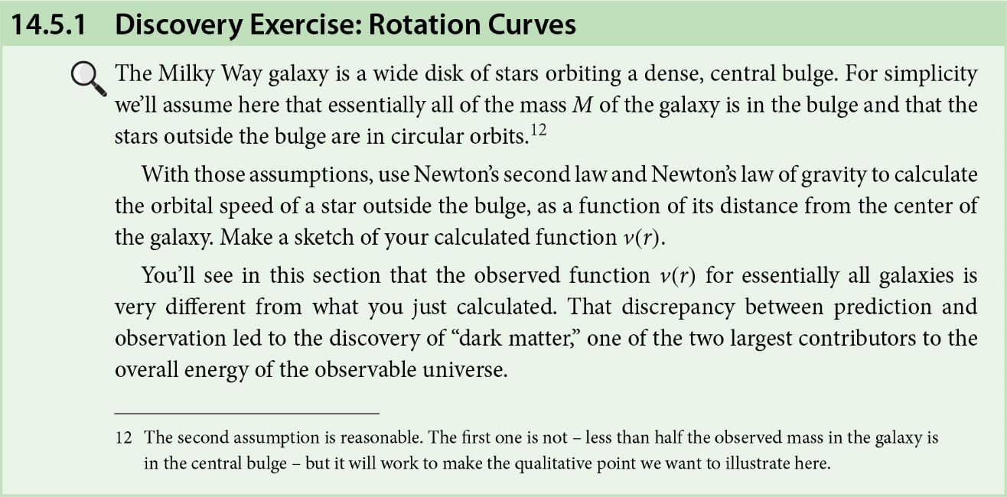
14 Cosmology
© Gary N. Felder and Kenny M. Felder 2023.

Slide 60
14 Cosmology
© Gary N. Felder and Kenny M. Felder 2023.

Slide 61
14 Cosmology
© Gary N. Felder and Kenny M. Felder 2023.

Slide 62
Online Chapter: General Relativity
© Gary N. Felder and Kenny M. Felder 2023.

Slide 63
Online Chapter: General Relativity
© Gary N. Felder and Kenny M. Felder 2023.

