Slide 2
1 Relativity I: Time, Space, and Motion
© Gary N. Felder and Kenny M. Felder 2023.

Slide 3
1 Relativity I: Time, Space, and Motion
© Gary N. Felder and Kenny M. Felder 2023.

Slide 4
1 Relativity I: Time, Space, and Motion
© Gary N. Felder and Kenny M. Felder 2023.

Slide 5
1 Relativity I: Time, Space, and Motion
© Gary N. Felder and Kenny M. Felder 2023.

Slide 6
1 Relativity I: Time, Space, and Motion
© Gary N. Felder and Kenny M. Felder 2023.

Slide 7
1 Relativity I: Time, Space, and Motion
© Gary N. Felder and Kenny M. Felder 2023.

Slide 8
1 Relativity I: Time, Space, and Motion
© Gary N. Felder and Kenny M. Felder 2023.

Slide 9
1 Relativity I: Time, Space, and Motion
© Gary N. Felder and Kenny M. Felder 2023.

Slide 10
1 Relativity I: Time, Space, and Motion
© Gary N. Felder and Kenny M. Felder 2023.

Slide 11
2 Relativity II: Dynamics
© Gary N. Felder and Kenny M. Felder 2023.

Slide 12
2 Relativity II: Dynamics
© Gary N. Felder and Kenny M. Felder 2023.

Slide 13
2 Relativity II: Dynamics
© Gary N. Felder and Kenny M. Felder 2023.

Slide 14
2 Relativity II: Dynamics
© Gary N. Felder and Kenny M. Felder 2023.

Slide 15
2 Relativity II: Dynamics
© Gary N. Felder and Kenny M. Felder 2023.

Slide 16
2 Relativity II: Dynamics
© Gary N. Felder and Kenny M. Felder 2023.

Slide 17
2 Relativity II: Dynamics
© Gary N. Felder and Kenny M. Felder 2023.

Slide 18
2 Relativity II: Dynamics
© Gary N. Felder and Kenny M. Felder 2023.

Slide 19
2 Relativity II: Dynamics
© Gary N. Felder and Kenny M. Felder 2023.

Slide 20
2 Relativity II: Dynamics
© Gary N. Felder and Kenny M. Felder 2023.

Slide 21
3 The Quantum Revolution I: From Light Waves to Photons
© Gary N. Felder and Kenny M. Felder 2023.

Slide 22
3 The Quantum Revolution I: From Light Waves to Photons
© Gary N. Felder and Kenny M. Felder 2023.

Slide 23
3 The Quantum Revolution I: From Light Waves to Photons
© Gary N. Felder and Kenny M. Felder 2023.

Slide 24
3 The Quantum Revolution I: From Light Waves to Photons
© Gary N. Felder and Kenny M. Felder 2023.

Slide 25
3 The Quantum Revolution I: From Light Waves to Photons
© Gary N. Felder and Kenny M. Felder 2023.

Slide 26
3 The Quantum Revolution I: From Light Waves to Photons
© Gary N. Felder and Kenny M. Felder 2023.

Slide 27
3 The Quantum Revolution I: From Light Waves to Photons
© Gary N. Felder and Kenny M. Felder 2023.

Slide 28
3 The Quantum Revolution I: From Light Waves to Photons
© Gary N. Felder and Kenny M. Felder 2023.

Slide 29
3 The Quantum Revolution I: From Light Waves to Photons
© Gary N. Felder and Kenny M. Felder 2023.

Slide 30
3 The Quantum Revolution I: From Light Waves to Photons
© Gary N. Felder and Kenny M. Felder 2023.

Slide 31
4 The Quantum Revolution II: Matter and Wavefunctions
© Gary N. Felder and Kenny M. Felder 2023.

Slide 32
4 The Quantum Revolution II: Matter and Wavefunctions
© Gary N. Felder and Kenny M. Felder 2023.

Slide 33
4 The Quantum Revolution II: Matter and Wavefunctions
© Gary N. Felder and Kenny M. Felder 2023.

Slide 34
4 The Quantum Revolution II: Matter and Wavefunctions
© Gary N. Felder and Kenny M. Felder 2023.

Slide 35
4 The Quantum Revolution II: Matter and Wavefunctions
© Gary N. Felder and Kenny M. Felder 2023.

Slide 36
4 The Quantum Revolution II: Matter and Wavefunctions
© Gary N. Felder and Kenny M. Felder 2023.

Slide 37
4 The Quantum Revolution II: Matter and Wavefunctions
© Gary N. Felder and Kenny M. Felder 2023.

Slide 38
4 The Quantum Revolution II: Matter and Wavefunctions
© Gary N. Felder and Kenny M. Felder 2023.

Slide 39
5 The Schrödinger Equation
© Gary N. Felder and Kenny M. Felder 2023.

Slide 40
5 The Schrödinger Equation
© Gary N. Felder and Kenny M. Felder 2023.

Slide 41
5 The Schrödinger Equation
© Gary N. Felder and Kenny M. Felder 2023.

Slide 42
5 The Schrödinger Equation
© Gary N. Felder and Kenny M. Felder 2023.

Slide 43
5 The Schrödinger Equation
© Gary N. Felder and Kenny M. Felder 2023.

Slide 44
5 The Schrödinger Equation
© Gary N. Felder and Kenny M. Felder 2023.

Slide 45
5 The Schrödinger Equation
© Gary N. Felder and Kenny M. Felder 2023.

Slide 46
5 The Schrödinger Equation
© Gary N. Felder and Kenny M. Felder 2023.

Slide 47
5 The Schrödinger Equation
© Gary N. Felder and Kenny M. Felder 2023.

Slide 48
5 The Schrödinger Equation
© Gary N. Felder and Kenny M. Felder 2023.

Slide 49
6 Unbound States
© Gary N. Felder and Kenny M. Felder 2023.

Slide 50
6 Unbound States
© Gary N. Felder and Kenny M. Felder 2023.

Slide 51
6 Unbound States
© Gary N. Felder and Kenny M. Felder 2023.

Slide 52
6 Unbound States
© Gary N. Felder and Kenny M. Felder 2023.

Slide 53
6 Unbound States
© Gary N. Felder and Kenny M. Felder 2023.

Slide 54
6 Unbound States
© Gary N. Felder and Kenny M. Felder 2023.

Slide 55
6 Unbound States
© Gary N. Felder and Kenny M. Felder 2023.

Slide 56
6 Unbound States
© Gary N. Felder and Kenny M. Felder 2023.

Slide 57
6 Unbound States
© Gary N. Felder and Kenny M. Felder 2023.

Slide 58
6 Unbound States
© Gary N. Felder and Kenny M. Felder 2023.

Slide 59
6 Unbound States
© Gary N. Felder and Kenny M. Felder 2023.

Slide 60
6 Unbound States
© Gary N. Felder and Kenny M. Felder 2023.

Slide 61
7 The Hydrogen Atom
© Gary N. Felder and Kenny M. Felder 2023.

Slide 62
7 The Hydrogen Atom
© Gary N. Felder and Kenny M. Felder 2023.

Slide 63
7 The Hydrogen Atom
© Gary N. Felder and Kenny M. Felder 2023.

Slide 64
7 The Hydrogen Atom
© Gary N. Felder and Kenny M. Felder 2023.

Slide 65
7 The Hydrogen Atom
© Gary N. Felder and Kenny M. Felder 2023.

Slide 66
7 The Hydrogen Atom
© Gary N. Felder and Kenny M. Felder 2023.

Slide 67
7 The Hydrogen Atom
© Gary N. Felder and Kenny M. Felder 2023.

Slide 68
7 The Hydrogen Atom
© Gary N. Felder and Kenny M. Felder 2023.

Slide 69
7 The Hydrogen Atom
© Gary N. Felder and Kenny M. Felder 2023.

Slide 70
8 Atoms
© Gary N. Felder and Kenny M. Felder 2023.

Slide 71
8 Atoms
© Gary N. Felder and Kenny M. Felder 2023.

Slide 72
8 Atoms
© Gary N. Felder and Kenny M. Felder 2023.

Slide 73
8 Atoms
© Gary N. Felder and Kenny M. Felder 2023.

Slide 74
8 Atoms
© Gary N. Felder and Kenny M. Felder 2023.

Slide 75
9 Molecules
© Gary N. Felder and Kenny M. Felder 2023.

Slide 76
9 Molecules
© Gary N. Felder and Kenny M. Felder 2023.

Slide 77
9 Molecules
© Gary N. Felder and Kenny M. Felder 2023.

Slide 78
9 Molecules
© Gary N. Felder and Kenny M. Felder 2023.

Slide 79
10 Statistical Mechanics
© Gary N. Felder and Kenny M. Felder 2023.

Slide 80
10 Statistical Mechanics
© Gary N. Felder and Kenny M. Felder 2023.

Slide 81
10 Statistical Mechanics
© Gary N. Felder and Kenny M. Felder 2023.

Slide 82
10 Statistical Mechanics
© Gary N. Felder and Kenny M. Felder 2023.

Slide 83
10 Statistical Mechanics
© Gary N. Felder and Kenny M. Felder 2023.

Slide 84
10 Statistical Mechanics
© Gary N. Felder and Kenny M. Felder 2023.

Slide 85
10 Statistical Mechanics
© Gary N. Felder and Kenny M. Felder 2023.

Slide 86
10 Statistical Mechanics
© Gary N. Felder and Kenny M. Felder 2023.

Slide 87
10 Statistical Mechanics
© Gary N. Felder and Kenny M. Felder 2023.

Slide 88
10 Statistical Mechanics
© Gary N. Felder and Kenny M. Felder 2023.

Slide 89
10 Statistical Mechanics
© Gary N. Felder and Kenny M. Felder 2023.

Slide 90
10 Statistical Mechanics
© Gary N. Felder and Kenny M. Felder 2023.

Slide 91
10 Statistical Mechanics
© Gary N. Felder and Kenny M. Felder 2023.

Slide 92
10 Statistical Mechanics
© Gary N. Felder and Kenny M. Felder 2023.

Slide 93
10 Statistical Mechanics
© Gary N. Felder and Kenny M. Felder 2023.

Slide 94
11 Solids
© Gary N. Felder and Kenny M. Felder 2023.

Slide 95
11 Solids
© Gary N. Felder and Kenny M. Felder 2023.

Slide 96
11 Solids
© Gary N. Felder and Kenny M. Felder 2023.

Slide 97
11 Solids
© Gary N. Felder and Kenny M. Felder 2023.

Slide 98
11 Solids
© Gary N. Felder and Kenny M. Felder 2023.

Slide 99
11 Solids
© Gary N. Felder and Kenny M. Felder 2023.

Slide 100
11 Solids
© Gary N. Felder and Kenny M. Felder 2023.

Slide 101
12 The Atomic Nucleus
© Gary N. Felder and Kenny M. Felder 2023.

Slide 102
12 The Atomic Nucleus
© Gary N. Felder and Kenny M. Felder 2023.

Slide 103
11 Solids
© Gary N. Felder and Kenny M. Felder 2023.

Slide 104
13 Particle Physics
© Gary N. Felder and Kenny M. Felder 2023.

Slide 105
13 Particle Physics
© Gary N. Felder and Kenny M. Felder 2023.

Slide 106
13 Particle Physics
© Gary N. Felder and Kenny M. Felder 2023.

Slide 107
13 Particle Physics
© Gary N. Felder and Kenny M. Felder 2023.

Slide 108
13 Particle Physics
© Gary N. Felder and Kenny M. Felder 2023.

Slide 109
13 Particle Physics
© Gary N. Felder and Kenny M. Felder 2023.

Slide 110
13 Particle Physics
© Gary N. Felder and Kenny M. Felder 2023.

Slide 111
13 Particle Physics
© Gary N. Felder and Kenny M. Felder 2023.

Slide 112
13 Particle Physics
© Gary N. Felder and Kenny M. Felder 2023.

Slide 113
13 Particle Physics
© Gary N. Felder and Kenny M. Felder 2023.

Slide 114
14 Cosmology
© Gary N. Felder and Kenny M. Felder 2023.

Slide 115
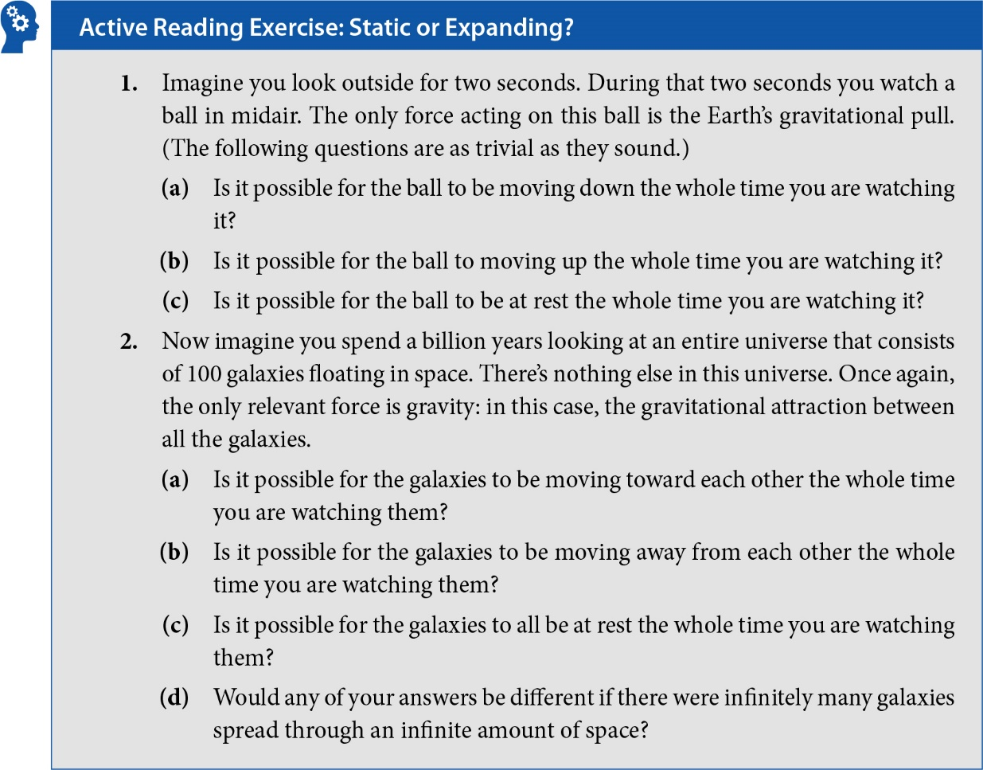
14 Cosmology
© Gary N. Felder and Kenny M. Felder 2023.

Slide 116
14 Cosmology
© Gary N. Felder and Kenny M. Felder 2023.

Slide 117
14 Cosmology
© Gary N. Felder and Kenny M. Felder 2023.

Slide 118
14 Cosmology
© Gary N. Felder and Kenny M. Felder 2023.

Slide 119
14 Cosmology
© Gary N. Felder and Kenny M. Felder 2023.

Slide 120
Online Chapter: General Relativity
© Gary N. Felder and Kenny M. Felder 2023.

Slide 121
Online Chapter: General Relativity
© Gary N. Felder and Kenny M. Felder 2023.

Slide 122
Online Chapter: The Quantum Eraser
© Gary N. Felder and Kenny M. Felder 2023.

Slide 123
Online Chapter: The Quantum Eraser
© Gary N. Felder and Kenny M. Felder 2023.

Slide 124
Online Chapter: The Quantum Eraser
© Gary N. Felder and Kenny M. Felder 2023.

Slide 125
Online Chapter: The Quantum Eraser
© Gary N. Felder and Kenny M. Felder 2023.

Slide 126
Online Chapter: The Quantum Eraser
© Gary N. Felder and Kenny M. Felder 2023.

Slide 127
Online Chapter: Wave Packets
© Gary N. Felder and Kenny M. Felder 2023.

Slide 128
Online Chapter: Wave Packets
© Gary N. Felder and Kenny M. Felder 2023.

Slide 129
Online Chapter: Wave Packets
© Gary N. Felder and Kenny M. Felder 2023.

Slide 130
Online Chapter: Wave Packets
© Gary N. Felder and Kenny M. Felder 2023.

